Slide 1
SMS Spam-Ham Detection
Watch video demo @ https://www.youtube.com/watch?v=iZPIKIlYfKU
A Novel Approach
Presented by - Vishal Punjabi, Deepen Panchal, Shivani Sharma, Preeti Tiwari

Slide 2
Content
Data Gathering
Data Cleansing
Data Analysis
Conventional Method – Naïve Bayes
Proposed Method – Neural Network
Comparative Analysis
Integration
Conclusion

Slide 3
Data Gathering – SMS Corpus
Training Dataset : UCI website https://archive.ics.uci.edu/ml/datasets/SMS+Spam+Collection
Test Dataset : http://www.esp.uem.es/jmgomez/smsspamcorpus/

Slide 4
Data Analysis
TRAINING DATASET
 | Total Messages
Labelled As HAM | 4827
Labelled As SPAM | 747
Total | 5574
TEST DATASET
 | Total Messages
Labelled As HAM | 1002
Labelled As SPAM | 322
Total | 1324

Slide 5
Data Preparation - Cleaning
Replace {£} by *pfund*
Replace {ü} by *u*
Replace {+} by *plus*
Replace {☺, :-) , -) , :-D , ☹, :/} by *smiley*
Remove some special characters {, “”,?,@,!,;&’,=,-,*,\,#,_,-}
Remove non ASCII characters ([^\x00-\x7F]+),
Replace {http://} by *http*
Remove Numbers

Slide 6
Conventional Method – Naïve Bayes
Assumed Independence between the input variables.
P(Y | X₁, X₂,…, X_{N}) = scalingfactor * P(X₁| Y ) * P(X₂| Y ) *… P(X_{N}| Y ) * P (Y)
Scalingfactor = P(X₁, X₂,…, X_{N})
P(SPAM | X₁, X₂,…, X_{N}) or P(HAM | X₁, X₂,…, X_{N})
WEKA:
Import the Training Dataset.
Use Filtered classifier, choose Filter StringToWord Vector.
Choose the NaiveBayes classifier.
Run the model and evaluate the results.

Slide 7
Evaluation – Naïve Bayes
Algorithms | Accuracy
ComplementNaiveBayes | 97.05%
DMNBtext | 98.14%
NaiveBayesMultimonial | 98.27%
NaiveBayes | 97.35%
Confusion Matrix
1000 (True Negative) | 2 (False Positive)
33 (False Negative) | 289 (True Positive)

Slide 8
Proposed Method – Neural Network
5574 sms’s
Feature Extraction
ANN Classifier
Training
Model
1324 sms’s
Feature Extraction
ANN Classifier
Recognition

Slide 9
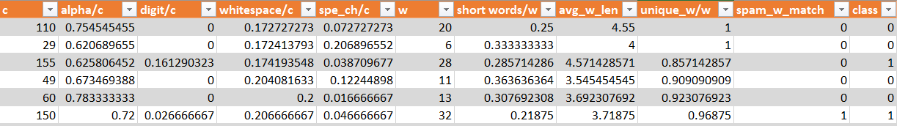
Feature Extraction
c = No of characters
alpha/c = ratio of no alphabets to all characters
digit/c = ratio of no of digits to all characters
whitespace/c = ratio of whitespace chars to all characters
spec_ch/c = ratio of special chars to all characters
w = No of words
short_words/w = ratio of no of words <= 2 chars to all words
avg_w_len = average word length
unique_w_match/w = ratio of no of unique words to all words
spam_w_match = presence of spam words

Slide 10
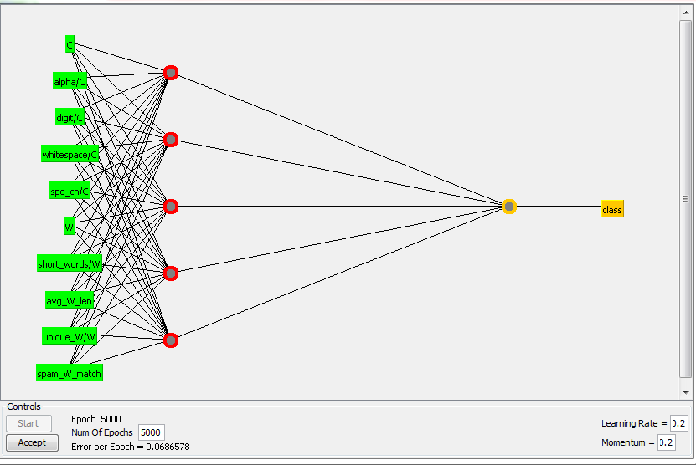
Network Model
Algorithm - MultiLayerPerceptron
Input Nodes – 10
Output Nodes – 1
Hidden Nodes – 5
Learning rate – 0.2
Momentum – 0.2
Training Time – 5000 epochs

Slide 11
Evaluation – Neural Network
Accuracy – 98.56 %
Misclassifications – 19 out of 1324
Mean Square Error- 0.0457
Confusion Matrix – Naïve Bayes
1000 (True Negative) | 2 (False Positive)
33 (False Negative) | 289 (True Positive)
Confusion Matrix – Neural Network
1000 (True Negative) | 2 (False Positive)
17 (False Negative) | 305 (True Positive)

Slide 12
Comparative Analysis
Parameter | Naïve Bayes | Neural Networks
Best Accuracy | 98.27 % | 98.56 %
Confusion Matrix | More False Negatives | More True Positives
Training Speed | 12.61s | 282.43s
Limitation | Word Dependent | Word Independent
Interpretation | Easy | Difficult

Slide 13
Integration
SMS Spam Filter Mobile Application.
Truecaller – source and peer review based classification
Continuous training
SPAM Classifier
New Message
SPAM
Extract Imp words and features
HAM

Slide 14
Conclusion
Which one is the best ?
Naïve Bayes or Neural Networks

Slide 15
Thank You !!

